Slide 1
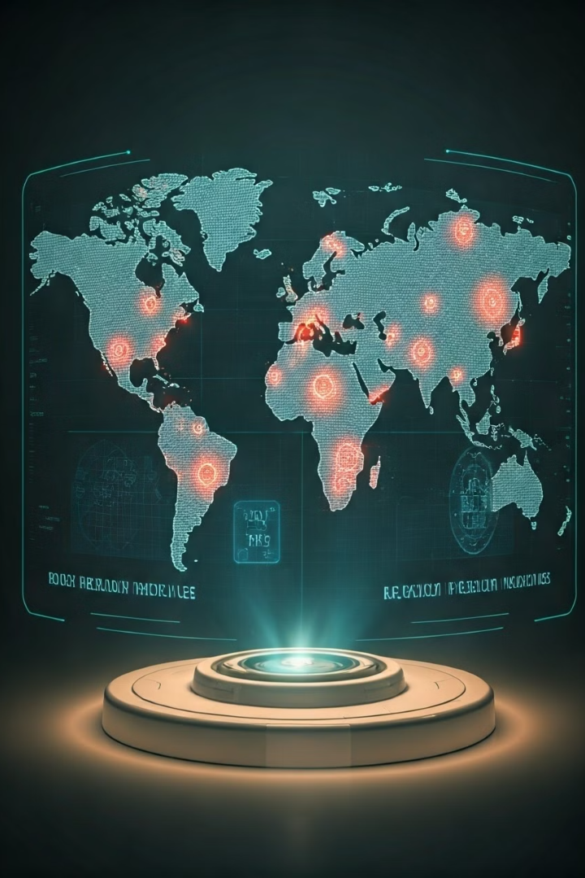
Innovative Global Disease Detection System
Reducing outbreak response time worldwide.
Presented by Samira, Autumn, and Cornelia.

Slide 2




Project Overview
Goal
Detect and respond to emerging diseases faster.
Focus
National and global scope for proactive measures.
Key Areas
Early detection, quick reporting, and outbreak containment.

Slide 3




Data Requirements
Medical Information
Environmental Data
Healthcare Access
Disease details, genetic profiles, and medical history patterns.
Weather patterns, air quality, and location tracking.
Availability, population density, and demographic information.

Slide 4

Technologies and Methods
1
Artificial Intelligence
Data analysis and NLP for early signal detection.
2
Genomic Algorithms
Rapid sequencing for pathogen mutations and treatment guidance.
3
Internet of Medical Things
Wearable devices for individual and environmental monitoring.

Slide 5

Strengths of the Approach
Early Detection
AI identifies unusual patterns quickly.
Quick Access
Faster data processing for immediate action.
Adaptability
Globally adaptable for urban and rural areas.
Improved Diagnostics
Better testing, treatments, and vaccines through genomics.

Slide 6

Limitations of the Approach
Limitation
Challenge
Funding and Resources
High costs for technology and updates
Data Privacy
Complex cross-border data sharing
Errors
False positives/negatives impacting trust and detection

Slide 7
Addressing Inequities
Acknowledgment
Affordable Solutions
Policy Advocacy
Prioritizing communities with fewer resources.
Technologies designed for lower costs.
Ensuring data protection to build trust.

Slide 8

Summary and Next Steps
1
Vision
Global, fair disease detection for all communities.
2
Impact
Stronger health security and worldwide readiness.
3
Next Steps
Prototype development, partnerships, and policy advocacy.

